Slide 1



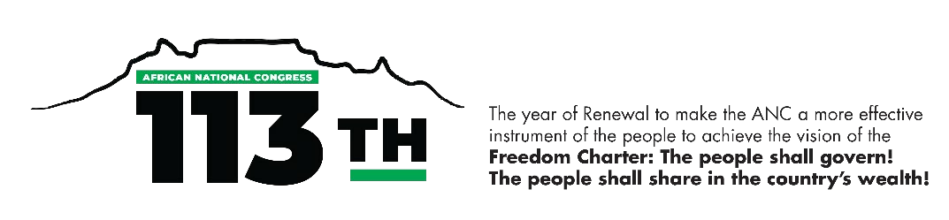
ANC 5th National General Council
Presentation to the Commissions
Gender and Equity
10 December 2025

Slide 2
PURPOSE
Provide highlights on the status of women in South Africa through data and statistics

Slide 3
INTRODUCTION
Contextualising Gender Equality in South Africa
Gender equality is a constitutional human right in South Africa.
The Constitution of the Republic of South Africa, 1996 (the Constitution), is the overarching legal framework which protects the rights of the citizens.
Section 9 of the Bill of Rights (Chapter 2 of the Constitution) stipulates the intent of promoting women’s economic emancipation and participation.
The Constitution is supported by various Acts of Parliament and other legal policy instruments related to women’s empowerment and gender equality.

Slide 4
INTRODUCTION
Contextualising Gender Equality in South Africa
The country has enacted various laws and policies to protect women's rights and promote gender equality. These include:
South African National policy framework on Women Empowerment and Gender Equality (2000)
The Promotion of Equality and Prevention of Unfair Discrimination Act, 2000 (Act No. 4 of 2000),
The Employment Equity Act, Act No. 55 of 1998
The Gender Equality Strategic Framework (GESF) for Public Service (2009)
Gender Responsive Planning, Budgeting, Monitoring, Evaluation and Auditing Framework (GRPBMEAF), 2019.
National Strategic Plan on Gender-based Violence and Femicide (2020)
National Council on Gender-Based Violence and Femicide Act 9 of 2024

Slide 5
INTRODUCTION
Contextualising Gender Equality in South Africa
South Africa is a signatory to several international and regional agreements that have resulted in specific gendered obligations.
Pertinent to women’s empowerment and gender equality are instruments which are Legally binding and Non-legally binding.
The 1995 Beijing Platform for Action (BPfA)
  Established a vision and set of goals for gender equality by outlining 12 "critical areas of concern" that governments and organizations work to address
The Convention on the Elimination of All Forms of Discrimination against Women(CEDAW, 1979)
  provides a legal and human rights frameworks or "compass," to guide countries on how to achieve those goals through specific actions and obligations.
Sustainable Development Goals (SDGs) -a global call to action to end poverty: Goal 5 of the SDGs seeks to achieve gender equality by 2030
The Protocol to the African Charter on Human and Peoples' Rights on the Rights of Women in Africa (Maputo Protocol) - international human rights instrument established by the African Union – adopted 2003 at came into effect in 2005
Gender Equality and Women's Empowerment (GEWE) Strategy 2018 –2028 of the African Union (AU)
Solemn Declaration on Gender Equality in Africa

Slide 6
BACKGROUND
55th CONFERENCE RESOLUTIONS ON GENDER AND EQUITY
The Conference reaffirmed the commitment to non-sexism and gender equality as core principles of a democratic South Africa. The key resolutions include:
Gender Representation and Leadership
Gender-Based Violence and Femicide (GBVF)
Women’s Economic Empowerment
Sexual and Reproductive Health and Rights (SRHR)
Gender Mainstreaming in Governance
Protection of Vulnerable Groups

Slide 7
STATUS OF WOMEN
FOCUS OF THE PRESENTATION
The presentation provides trends and patterns in women empowerment, with specific focus on economic, social and political domains to ascertain progress toward gender equality.

Slide 8
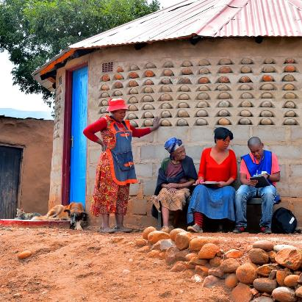
Household Characteristics

Slide 9
More than two-fifths (42,4%) of all households were headed by females.
Percentage of female-headed households by province, 2024
Female heads were most common in rural areas (47,1%),
Source: General Household Survey 2024
9

Slide 10
Close to half of households headed by Women in EC, FS, LP and NW do not have an employed household member within the household
Households without an employed household member by province and sex of household head, 2024
Men
Women
10
Source: General Household Survey 2024

Slide 11
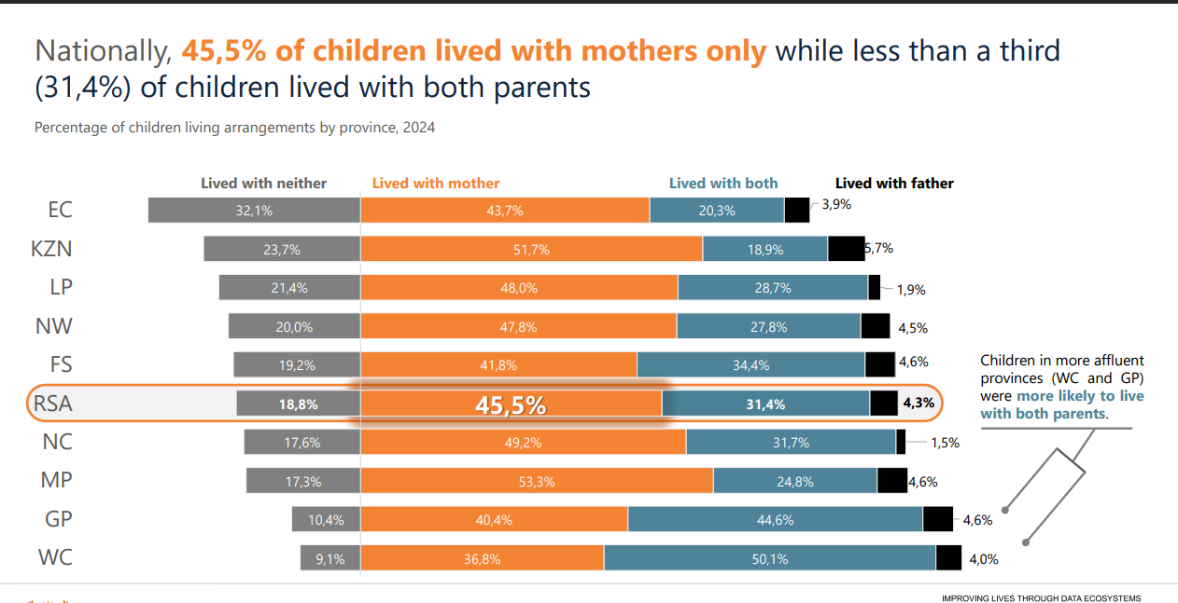
Living Arrangements

Slide 12
Women and Health
Article 12 of the CEDAW addresses women's health by mandating that states eliminate discrimination in healthcare access and services.
This includes ensuring equal access to family planning, primary healthcare, and maternal and reproductive health services,
It also requires States Parties to take measures to ensure women's safety and health in the workplace, such as protection for the reproductive function.
The Beijing Platform for Action recognizes that women's health is integral to development and requires addressing discriminatory attitudes and structures that limit their access to resources

Slide 13
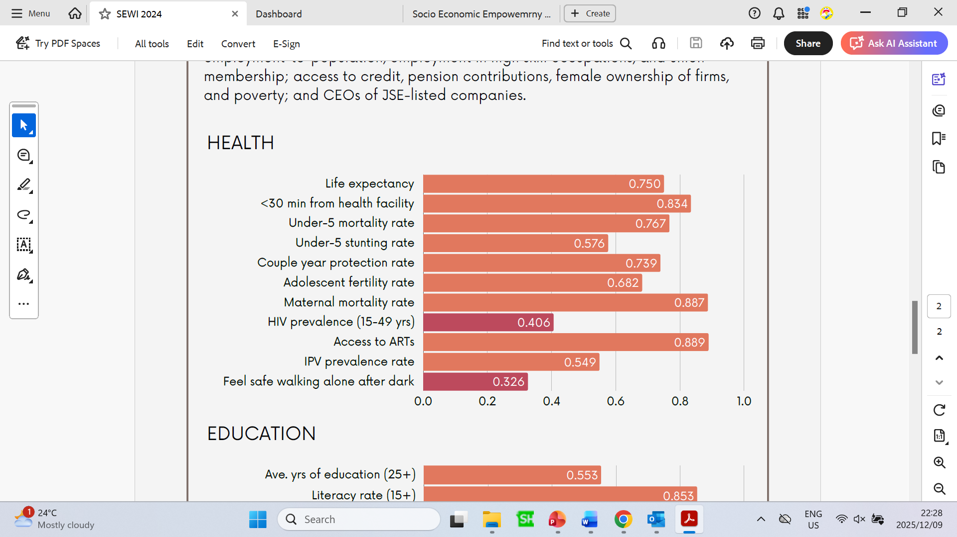
Health Indicators
Key indicators of concern (with low scores) are highlighted in red. These include HIV prevalence, and feeling safe;

Slide 14
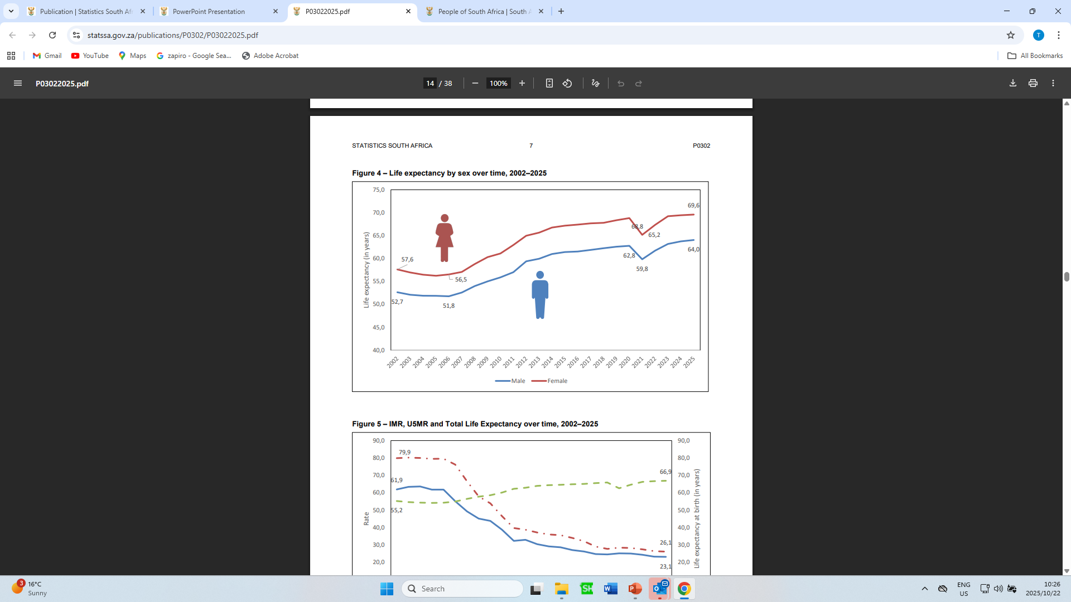
Life Expectancy
Life expectancy at birth - average number of years a newborn infant is expected to live if current mortality patterns remain constant throughout its life.
Life expectancy at birth for 2025 is estimated at 64,0 years for males and 69,6 years for females.

Slide 15
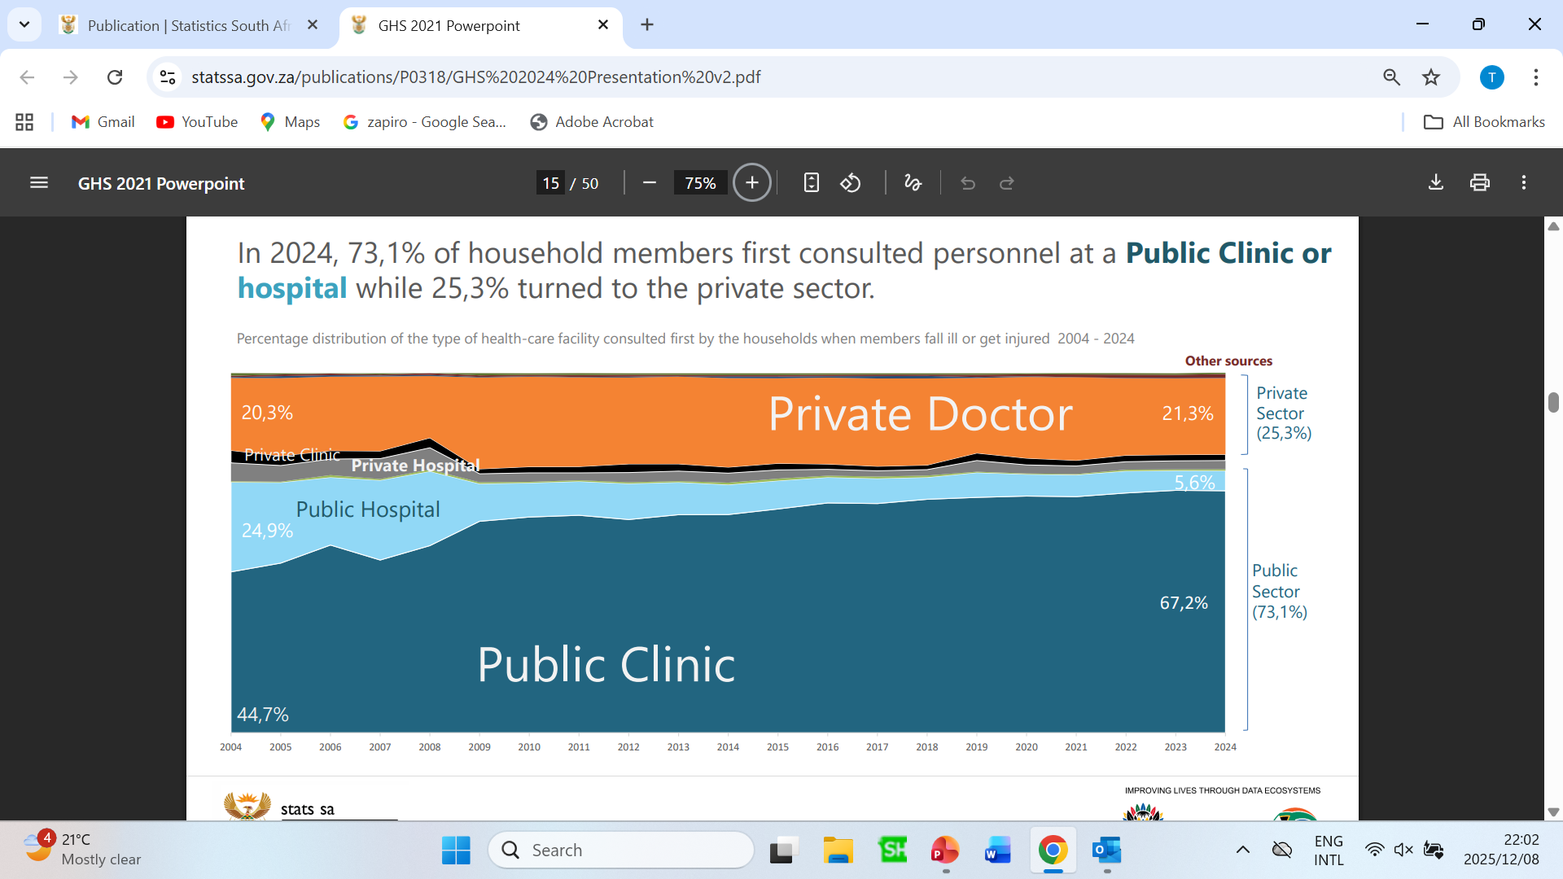
ACCESS TO HEALTH SERVICES

Slide 16
ACCESS TO HEALTH SERVICES

Slide 17
HIV prevalence by selected age groups, 2002–2025 (MYPE,2025)

Slide 18
ECONOMIC EMPOWERMENT
Economic empowerment is regarded as a powerful tool against poverty
Employment or running a business provides individuals with a strong sense of economic independence, enabling them to contribute to the household’s welfare.
The participation of females in the economy is vital as it gives them access and control over resources and enables them to earn income to support their households.
However, some studies suggest that if there are existing gender gaps in accessing economic opportunities, the quality and quantity of the labour supply will be distorted and inefficient, negatively affecting productivity and economic growth.

Slide 19
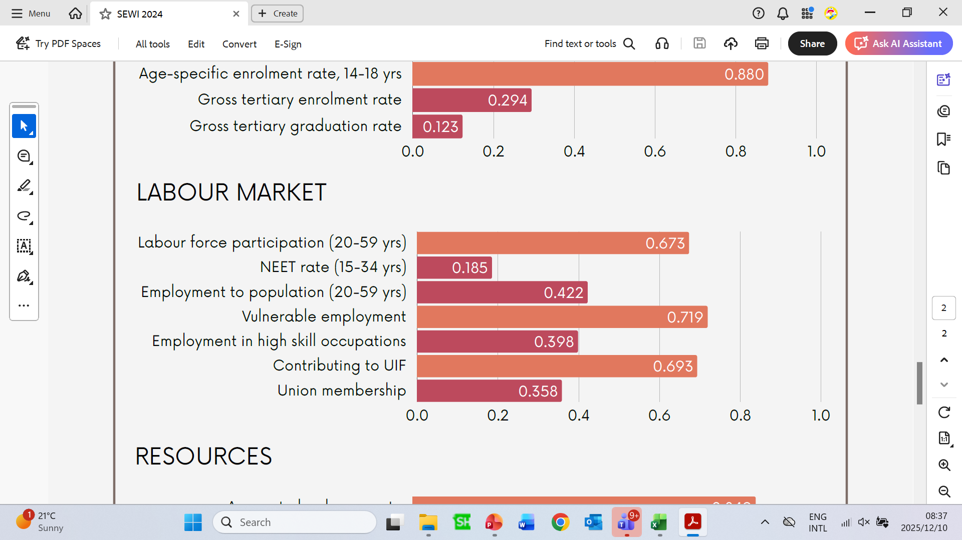
ECONOMIC EMPOWERMENT

Slide 20
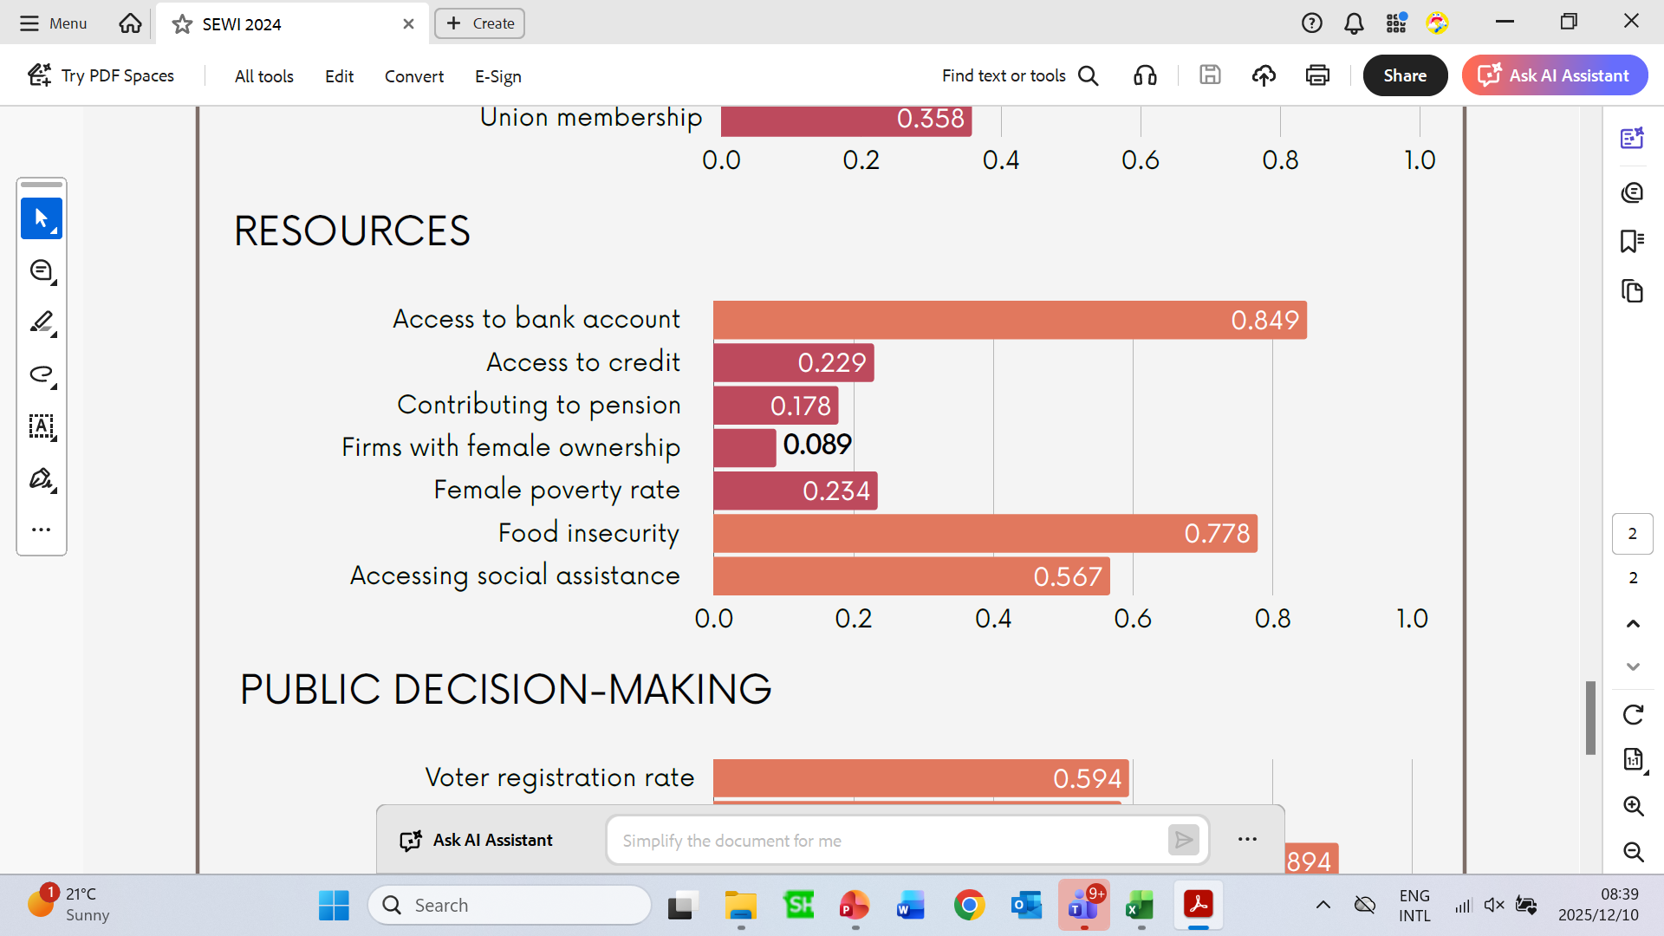
ECONOMIC EMPOWERMENT

Slide 21
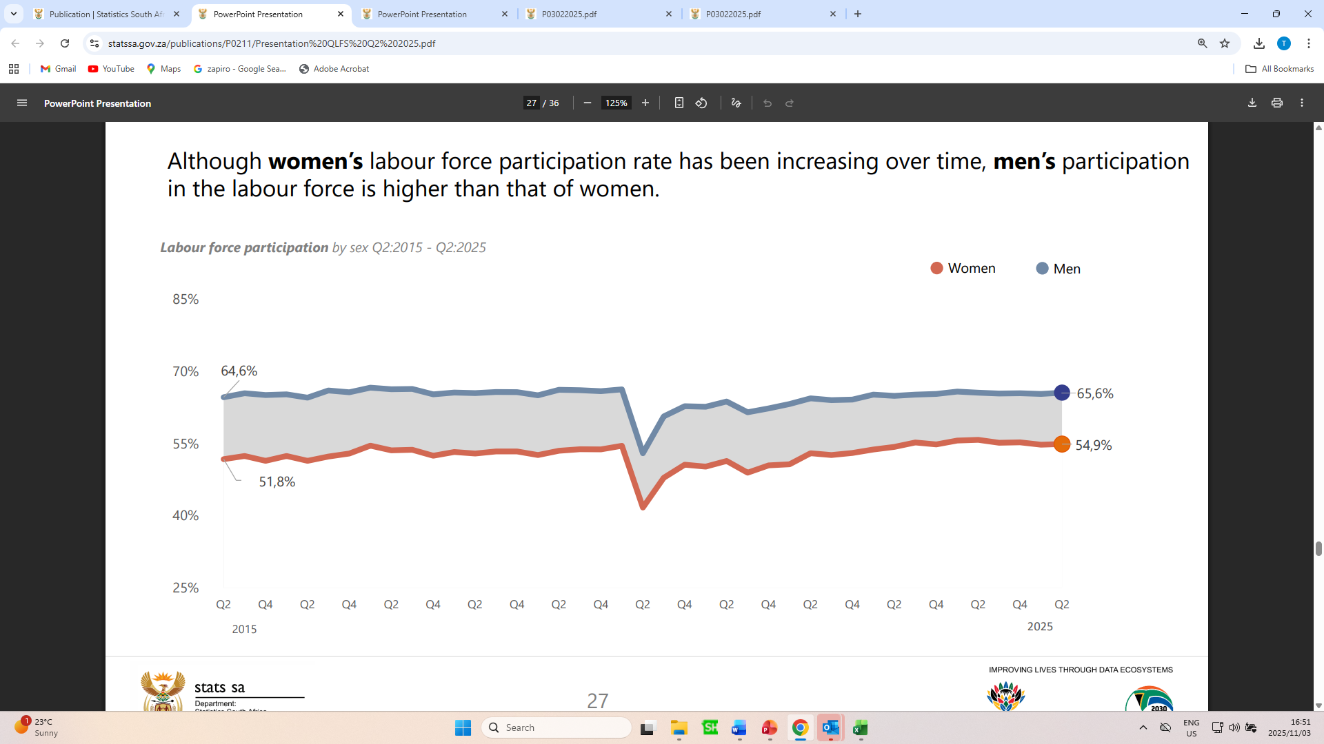
Labour Force Participation

Slide 22
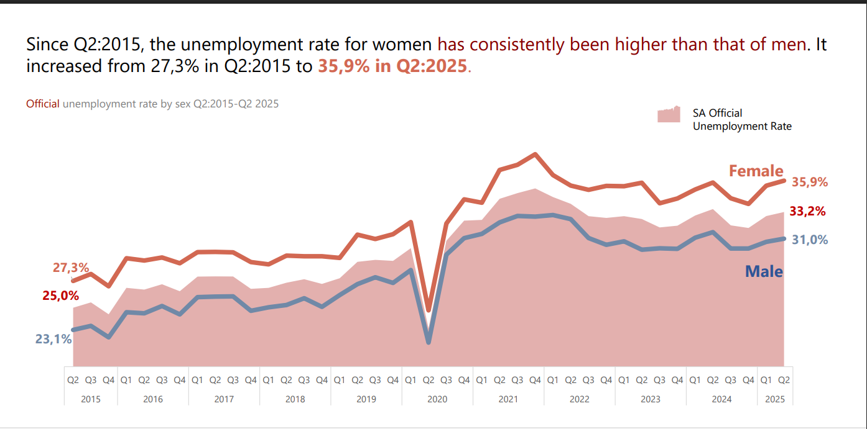
UNEMPLOYMENT

Slide 23
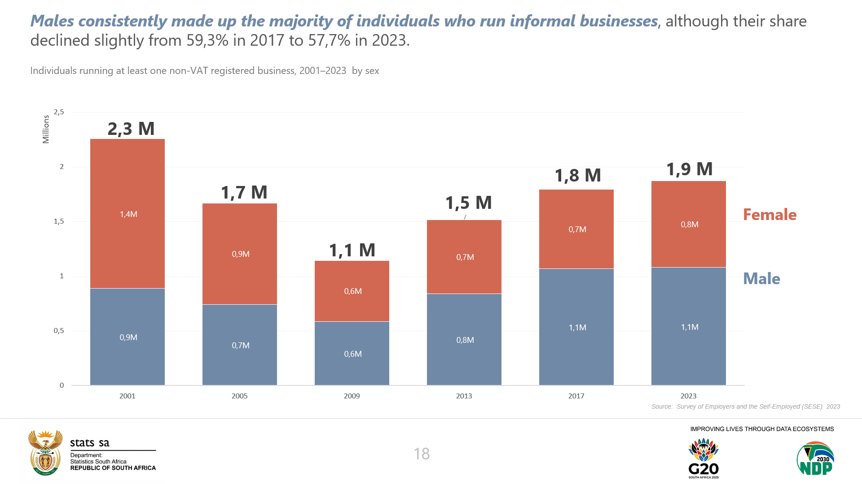
INFORMAL BUSINESS

Slide 24
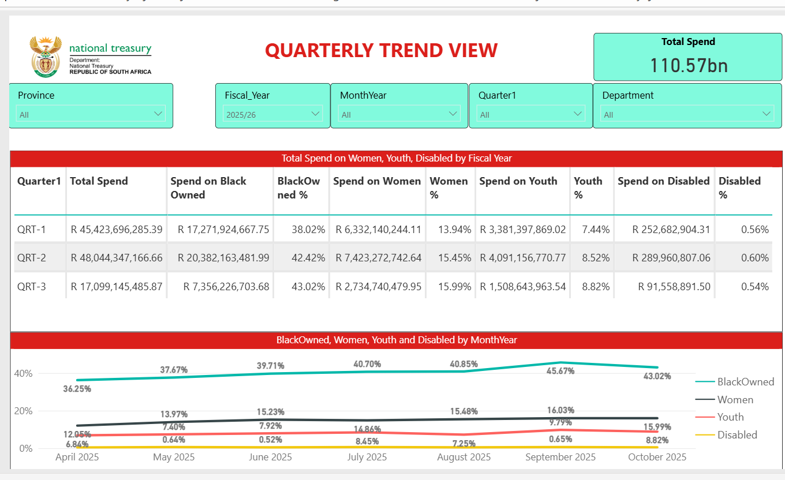
Procurement Spend Database for WYPD Owned Businesses

Slide 25
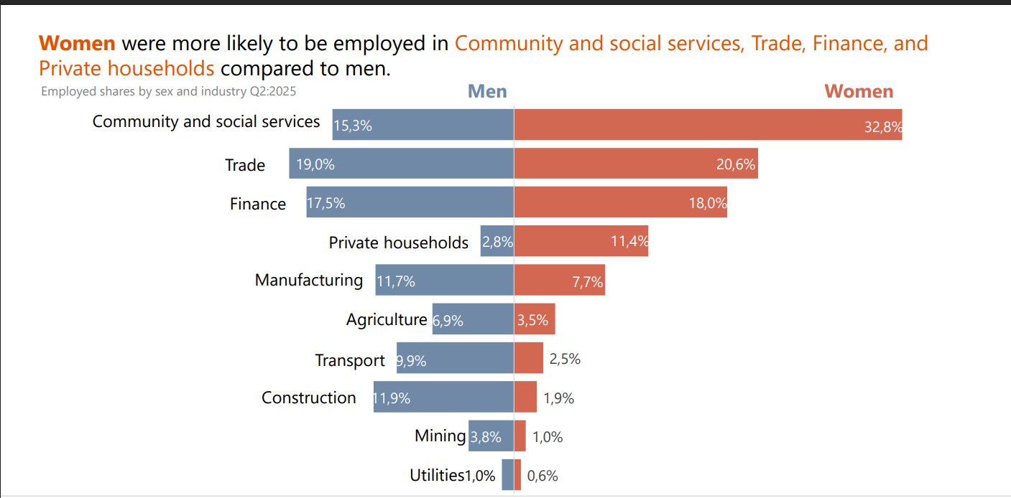
EMPLOYMENT

Slide 26
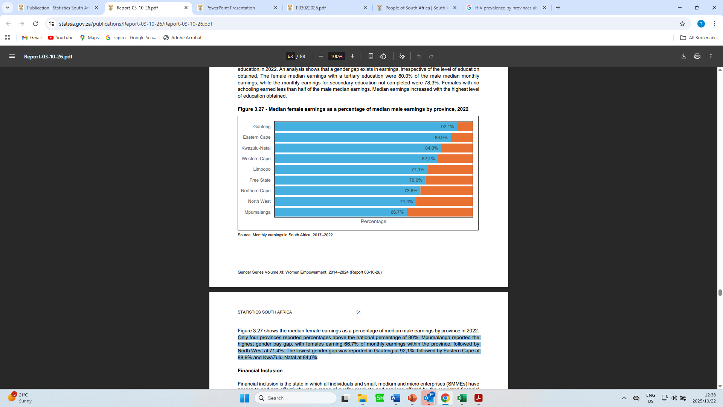
GENDER PAY GAP
2024 World Economic Forum Gender Pay Gap Report rated South Africa at 113 out of 146 countries on gender wage equity.
In the private sector, the wage equity gap between men and women is extremely wide.
Median earnings of males has been continually higher than the earnings for females.
An analysis shows that a gender gap exists in earnings, irrespective of the level of education obtained.

Slide 27
Freedom from violence, stigma and stereotypes
The CEDAW addresses gender-based violence by defining it as a form of discrimination and a human rights violation that States have a duty to eliminate.
Through General Recommendations, the committee clarifies that states must act with due diligence to prevent, investigate, and punish gender-based violence, whether perpetrated by the state or by private actors.
This includes changing laws and social norms that facilitate such violence and ensuring women have access to justice and remedies
The African Union have adopted a Convention on Ending Violence Against Women and Girls (AUCEVAWG) which is a comprehensive legal instrument for the prevention and elimination of all forms of violence against women and girls on the Continent in February 2025.
In late August-early September 2019, the scourge of gender-based violence and violence against women and children increased to the extent that it was declared “more than a national crisis”.
There was much action taken since then, and the champion of the cause against GBVF in the country.

Slide 28









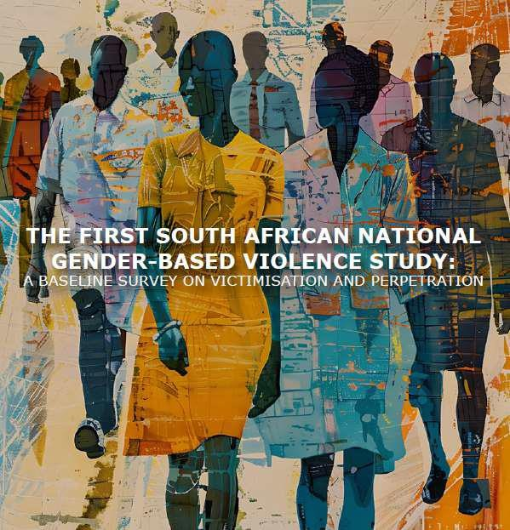

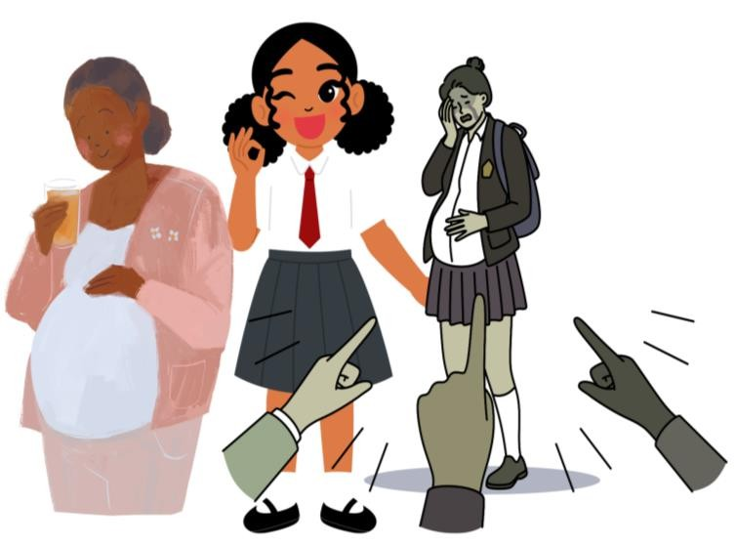


Setting the Scene – GBVF Context
01
The findings of the HSRC National GBV Study provide critical baseline data on the prevalence and patterns of GBV.
02
03
Police records (reported cases, teenage pregnancy statistics (hidden sexual violence)
Femicide findings of the South African Medical Research Council (extreme form of GBV).

Slide 29
SEXUAL OFFENCES REPORTED TO SAPS

Slide 30
PARTICIPATION, ACCOUNTABILITY AND GENDER-RESPONSIVE INSTITUTIONS
This section Highlights status of women regarding:
Representation of women in the national assembly.
Women in decision making – Ministers and Deputy Ministers
Decision-making positions at the local level
Workforce profiles at Top and Senior management

Slide 31
POLITICAL REPRESENTATION
Women holding seats in the National Parliament, following the 2024 National Elections, has decreased by 3 percentage points from the previous (6th) Parliament
Of the 400 seats, only 171 are occupied by women.
The two most powerful positions in the National Assembly of National Speaker and Deputy Speaker are both women,
Of the total of 75 Executive Members appointed in June 2024, 32 are women (i.e. 42.66%).
There are 14 women (i.e. 43.75%) out of 32 Cabinet Ministers appointed, dropping from the 50% representation of women in the 6th Administration.
There are 18 women (i.e. 41.86%) out of 43 Deputy Ministers.
Many of these Women Ministers and Deputy Ministers are young women, and representative of the LGBTQIA+ sector.

Slide 32
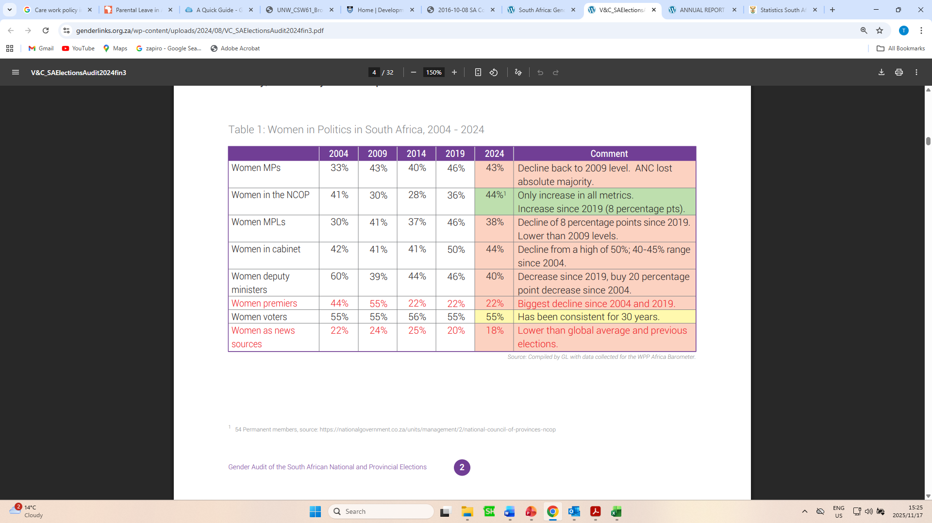
POLITICAL REPRESENTATION

Slide 33
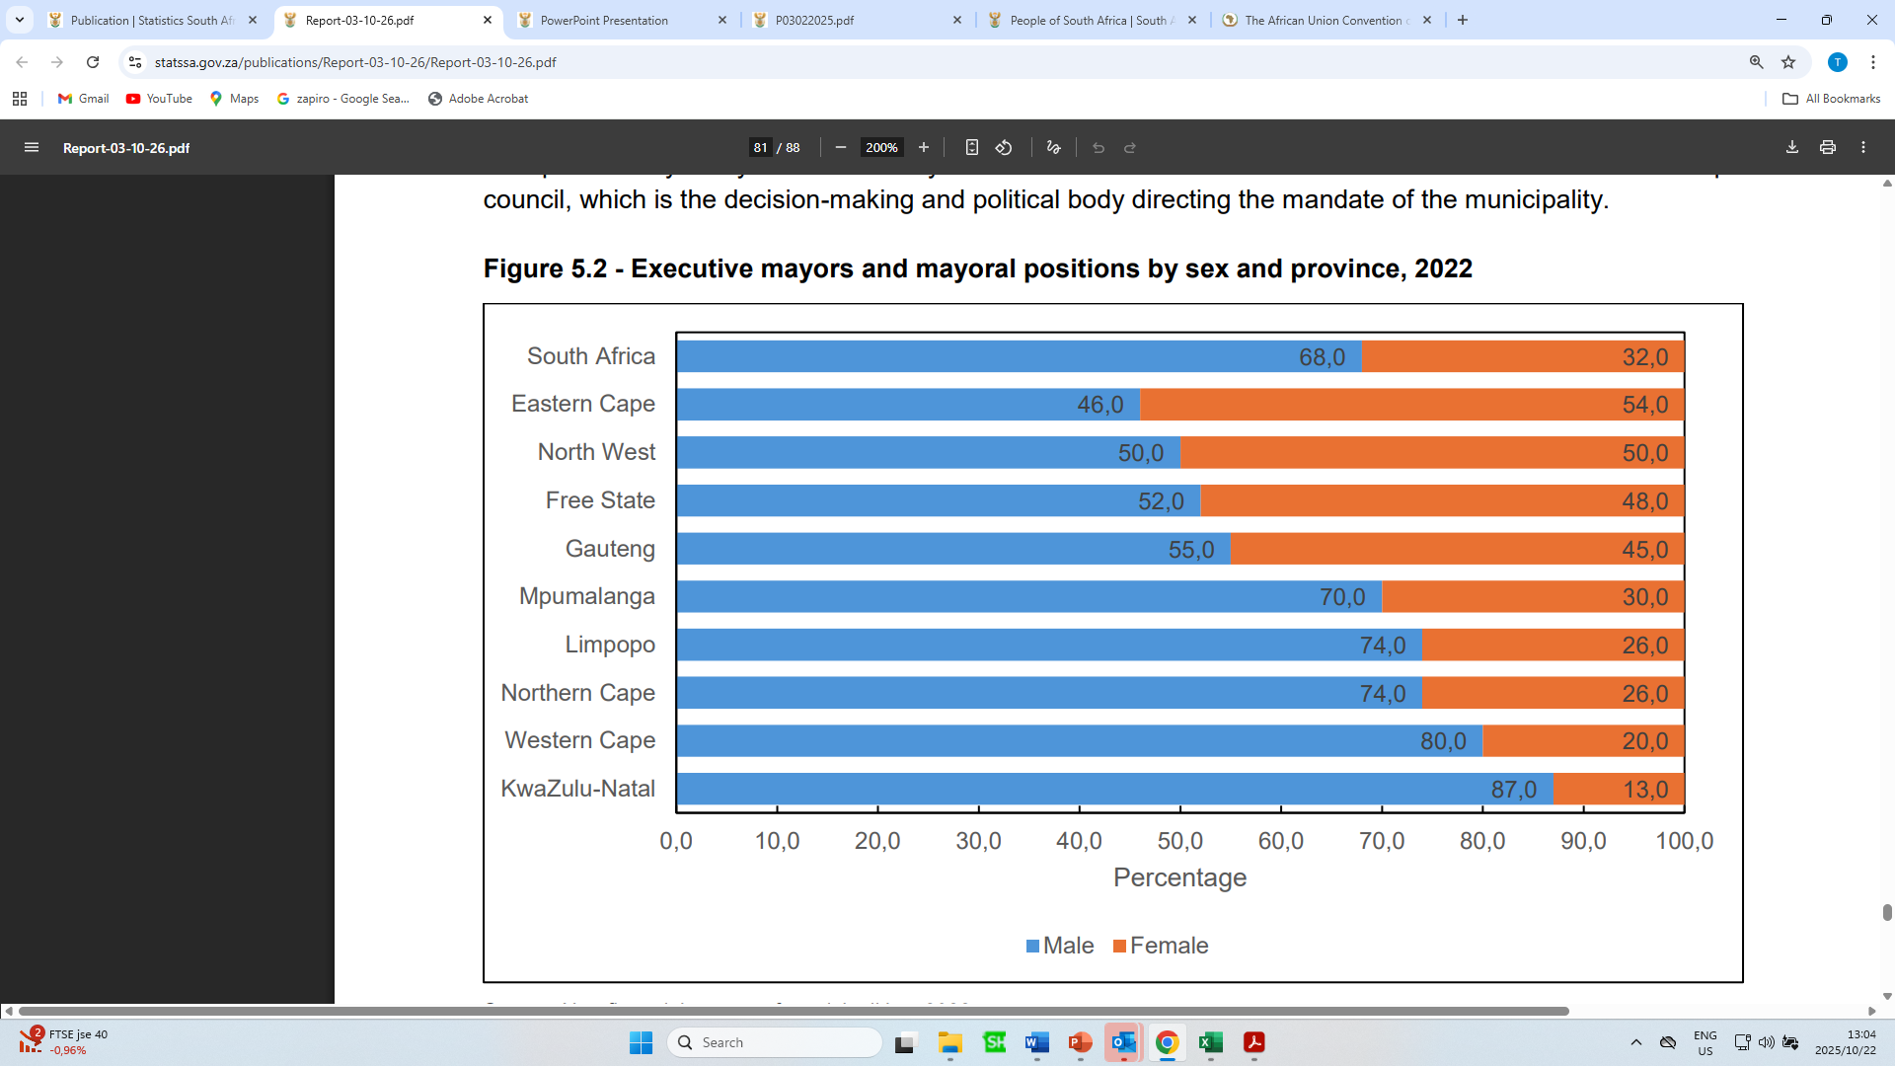
Decision-making positions at the Local level
Local government is the sphere of government closest to the persons and is responsible for providing basic services such as water, electricity and sanitation to communities across the country.
The municipal elections take place every five years where mayors and councillors are elected. These members sit on the municipal council, which is the decision-making and political body directing the mandate of the municipality.
Nationally, males were more likely to hold mayoral positions than females (68,0% vs 32,0%).
North-West is the only municipality with parity regarding mayoral positions.
Eastern Cape was the only province where the females occupied the highest proportions of mayoral positions compared to their male counterparts.
Only 45% of executive mayors in GP are female.

Slide 34
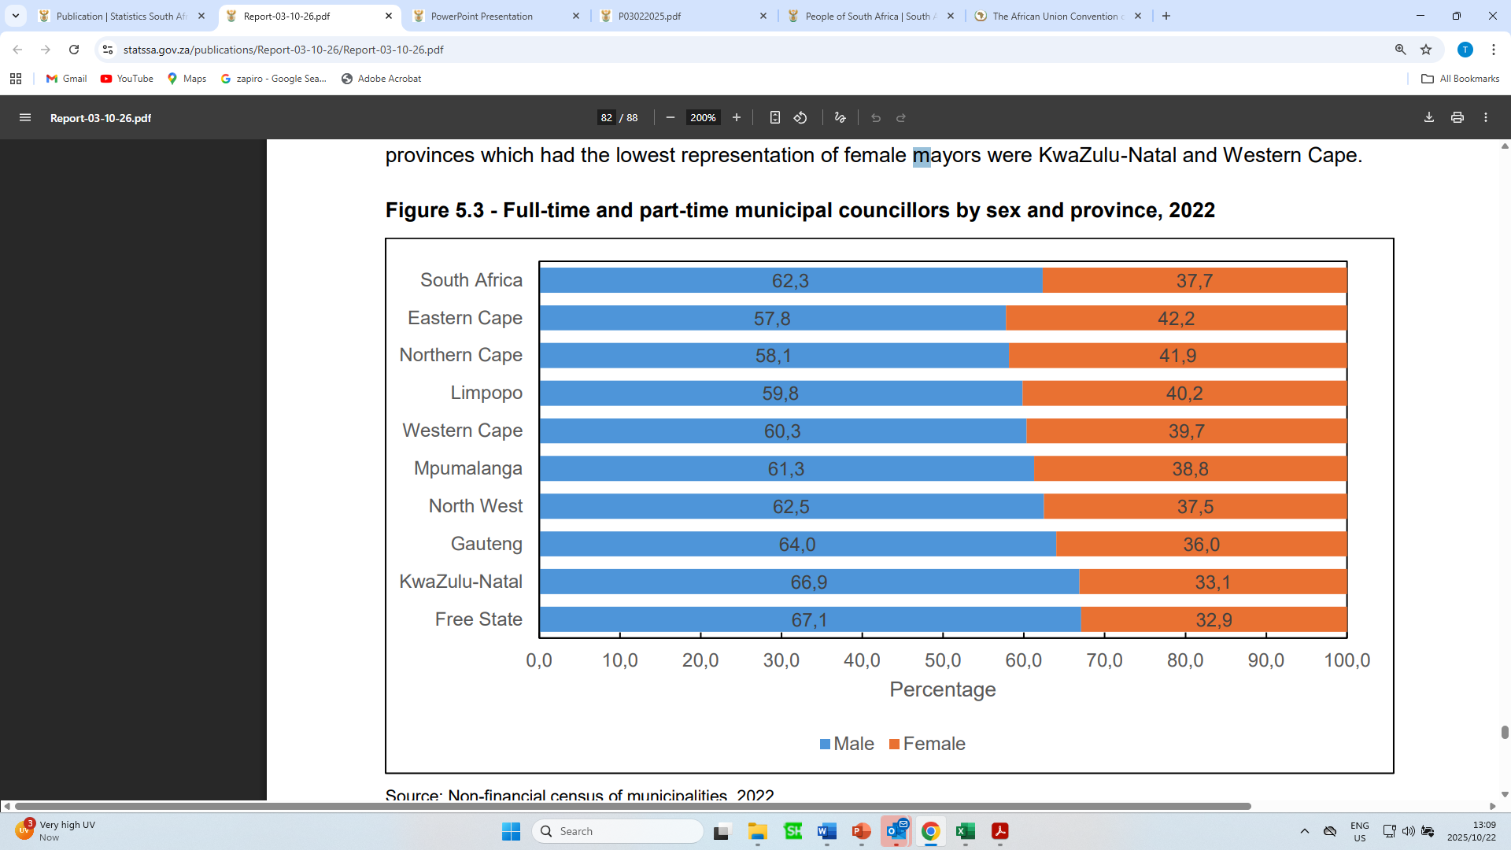
Decision-making positions at the Local level
Councillors are entrusted to work in local communities to address development and empowerment issues.
This requires gender mainstreaming and sensitivity, i.e. being aware of the issues around gender, and ensuring that these are taken into consideration when drafting programmes and making decisions.
The graph below show that the majority of municipal councillors are males.
Nationally, 37,7% of the municipal councillors were females.

Slide 35
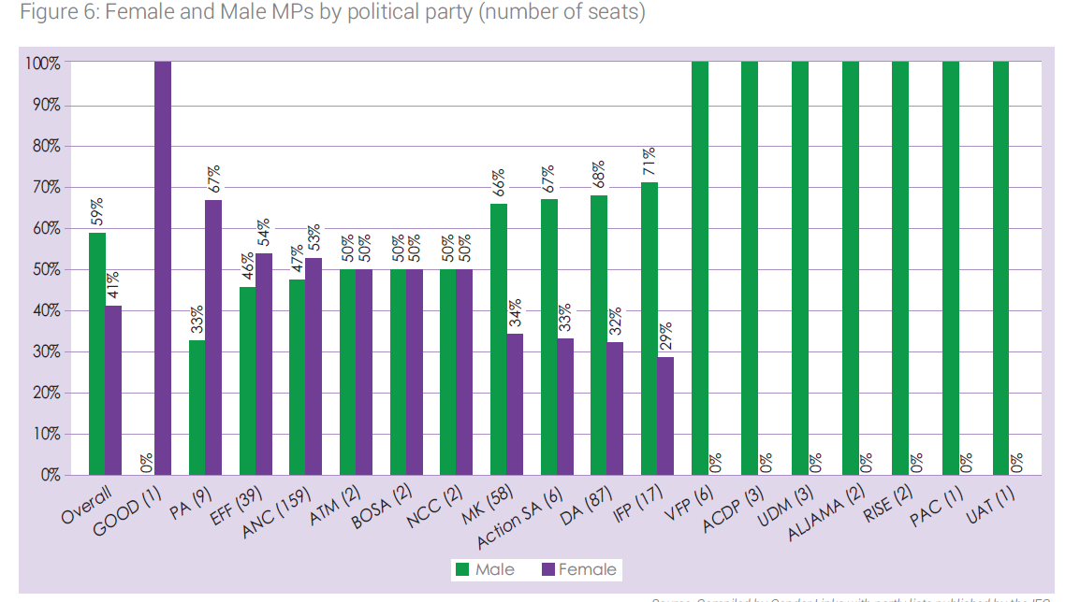

Slide 36
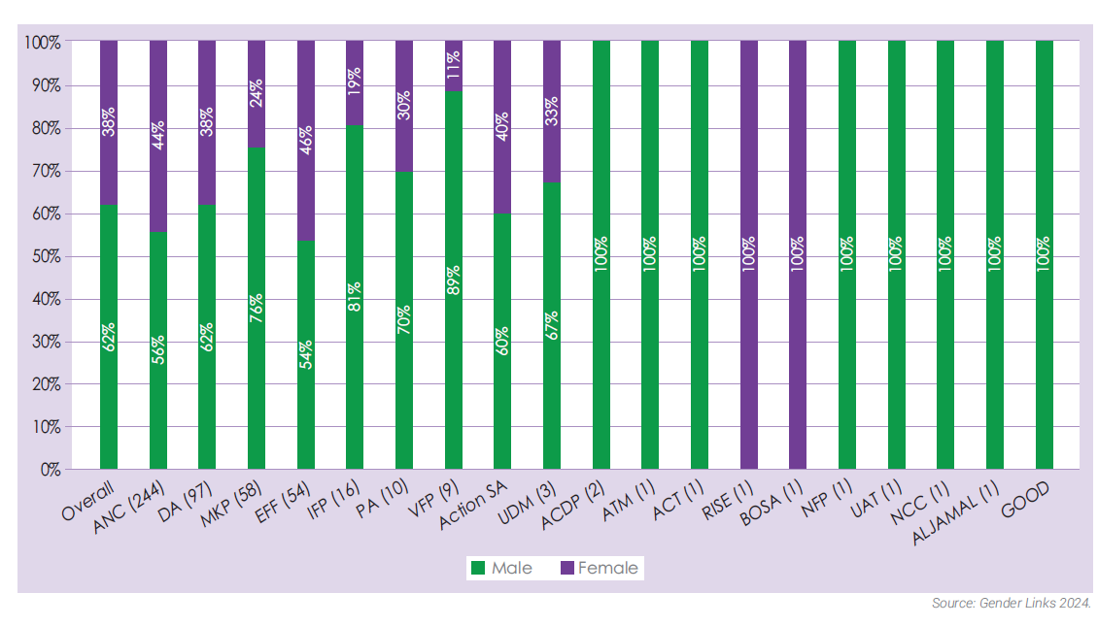
Women's representation in Provincial legislatures by elected political parties

Slide 37
Assessment of gender in top five party manifestos
Party | Quota for women's political participation | Gender as standalone issue in the manifesto | Gender mainstreamed in all areas of the manifesto | LGBTI+ and diversity | GBVF | SRHR | Law, policy & practise | Economic Empowerment Yes
ANC | Not in Manifesto but Rule 6 of the constitution covers this - 50% quota | NO | YES | YES | YES | NO | YES | YES
DA | NO | NO | NO | NO | YES | NO | NO | NO
EFF | YES | YES | NO | YES | YES | YES | YES | YES
MKP | NO | NO | NO | NO | YES | NO | NO | YES
IFP | NO | NO | NO | NO | YES | NO | NO | NO

Slide 38
Thank you

